Slide 1
ENHANCED ENTITY RELATIONSHIP MODELING Session 21&22
Course : ISYS6280 – Database Systems (GAT)
Year : 2017

Slide 2
LEARNING OUTCOME
LO 3: Design database using object oriented data model

Slide 3

ACKNOWLEDGEMENT
These slides have been adapted from Thomas Connolly and Carolyn Begg. 2015. Database Systems: A Practical Approach To Design, Implementation, and Management. Pearson Education. USA. ISBN:978-1-292-06118-4

Slide 4
CHAPTER 13 ENHANCED ER MODELING

Slide 5
LEARNING OBJECTIVES
Most useful additional data modeling concept of Enhanced ER (EER) model which called specialization/generalization
Aggregation
Composition
Notes:
Revisi Ganjil 17/18

Slide 6
Enhanced Entity-Relationship Model
Since 1980s there has been an increase in emergence of new database applications with more demanding requirements.
Basic concepts of ER modeling are not sufficient to represent requirements of newer, more complex applications.
Response is development of additional ‘semantic’ modeling concepts.
Semantic concepts are incorporated into the original ER model and called the Enhanced Entity-Relationship (EER) model.

Slide 7
Three Enhancement Types of the EER model
Generalization/ Specialization
Composition
Aggregation

Slide 8
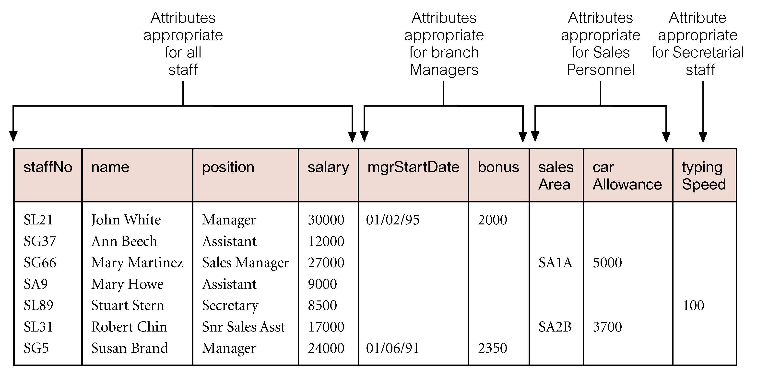
AllStaff relation holding details of all staff

Slide 9
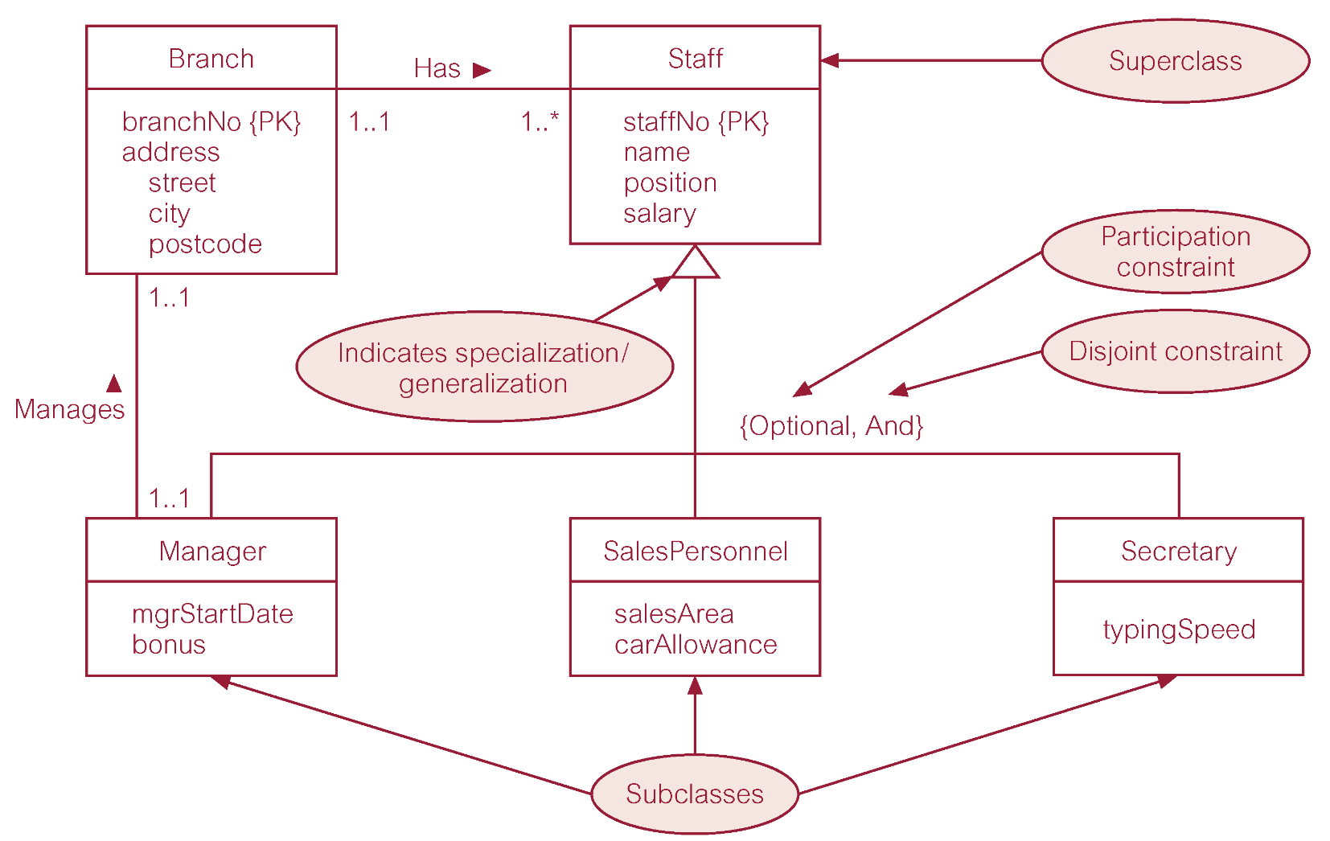
Generalization/ Specialization

Slide 10
Constraints on Generalization/ Specialization
Two constraints : Participation constraints & Disjoint constraints.
Participation constraint
Determines whether every member in superclass must participate as a member of a subclass.
May be mandatory or optional.
Disjoint constraint
Describes relationship between members of the subclasses and indicates whether member of a superclass can be a member of one, or more than one, subclass.
May be disjoint or nondisjoint.

Slide 11
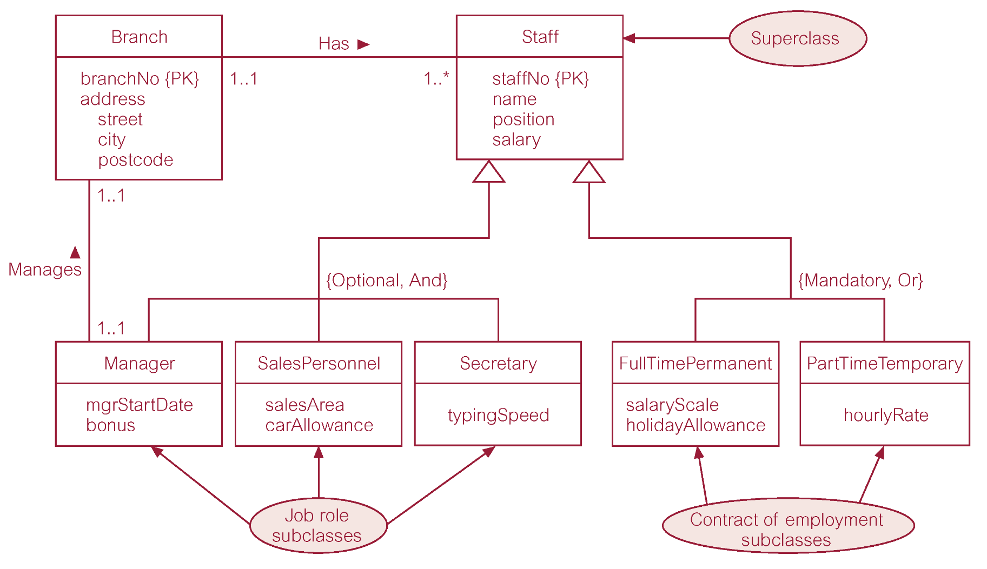
Generalization/ Specialization
Participation constraint
Participation constraint
Nondisjoint constraint
Disjoint constraint

Slide 12
Entity representing “part” in Has relationships
Entity representing “whole” in Has and Offers relationships
Has
Indicates aggregation
Oversees
Offers
Aggregation
Entity representing “part” in Offers relationships

Slide 13

Composition
Entity representing “part” in Displays relationship
Displays
Indicates composition
Entity representing “whole” in Displays relationship

Slide 14
Case Study 1
As a database game designer you are prompted to create an entity relationship diagram for a game with genre of Role-Playing games that meet the following conditions :
Games have to use a theme related to the history of Indonesia
Games must have a value of friendship
Games can be played in multi-player
Games have a feature to switch the type of character (job)
Games have the quest that must be executed by the player every day
Games allowed between players to exchange goods / items

Slide 15
Case Study 2
Please create entity relationship diagram for Super Mario Bross Game !
One day the kingdom of the peaceful mushroom people was invaded by the Koopa, a tribe of turtles famous for their black magic. The quiet, peace-loving Mushroom People were turned into mere stones, bricks and even field horse-hair plants, and the Mushroom Kingdom fell into ruin.
The only one who can undo the magic spell on the Mushroom People and return them to their normal selves is the Princess Toadstool, the daughter of the Mushroom King. Unfortunately, she is presently in the hands of the great Koopa turtle king.
Mario, the hero of this story hears about the Mushroom People's plight and sets out on a quest to free the Mushroom Princess from the evil Koopa and restore the fallen kingdom of the Mushroom People. You are Mario! It's up to you to save the Mushroom People from the black magic of the Koopa!

Slide 16
Case Study 2
You are Mario, the plumber (or Luigi, his brother), and you have to navigate the Mushroom Kingdom to rescue Princess Toadstool, who has been captured by King Koopa. His minions are all over the Kingdom, but you can knock them out by jumping at them or launching fireballs at them, if you get a fire flower.
Pipes are often gateways to secret areas, but some of them have enemies growing out of them!
If you get touched by an enemy, you die, unless you are powered up by a mushroom or flower, then you will revert to small Mario again, and die the next time you touch an enemy.
The physical world of Mario Bros. is rather straightforward; Mario can jump around, go underground into caves and such, and so forth. Mario can duck into pipes and often end up in secret areas.

Slide 17
Case Study 2
The following describes the key components of the physical world.
Travel
The player can advance to the right towards the end of a level, but cannot go back; once the world has scrolled to the right, it will not go back.
Objects
Mushroom – makes Mario larger, which allows him to reach (or not reach) certain areas, and also gives Mario extra protection from enemies
Fire Flower – gives Mario the ability to shoot fireballs at his enemies
Star-man – gives Mario invincibility for a short while
1-Up Mushroom – gives Mario an extra life
Coin – gives you points, and 100 of them earn you an extra life

Slide 18
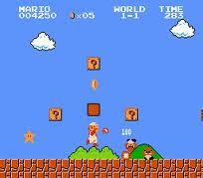
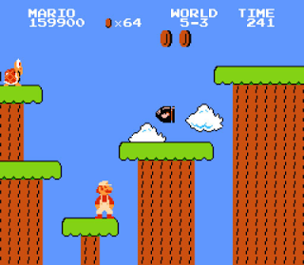
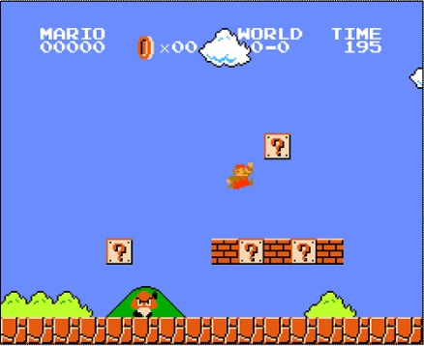
Case Study 2
Time
The timer begins counting down when the level starts; you get more points for completing a level more quickly. You die if it runs out. If you complete the level when the timer ends in 1, 3, or 6, you get fireworks and extra points.
The victory condition is each level will completed by progressing to the end of it; at the end of each world, Mario must battle inside a Koopa castle.

Slide 19

www.healthytravelblog.com

